Slide 1
ORBITAL DEBRIS: WHY THE SPACE ENVIRONMENT DESERVES PROTECTION TOO
Ivonne Rodriguez
(Ivonne.M.Rodriguez@nasa.gov)
Scott Hull
(Scott.M.Hull@nasa.gov)

Slide 2
Agenda
Introduction
Orbital Debris: definitions and sources
Orbital Debris in Earth orbit
Mitigation and Prevention
NASA Documents
ODAR and EOMP
NASA-STD-8719.14C Requirements
Remediation
Challenges to Removing Large Debris ( > 1 m)
Challenges to Removing SmallSat Debris ( 2 cm to 1 m)
Challenges to Removing Small Debris ( < 2 cm)
Questions

Slide 3
Introduction

Slide 4
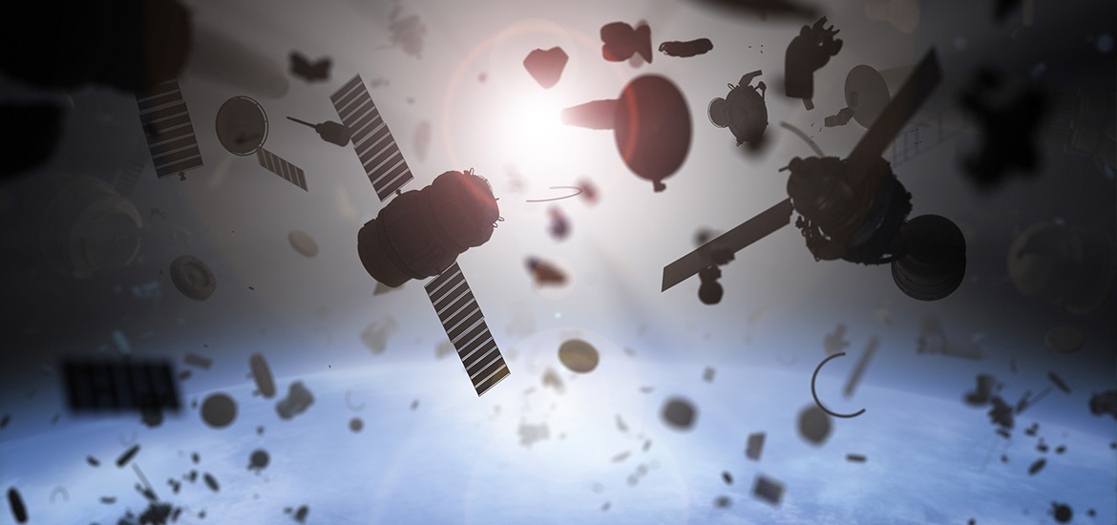
What is Orbital Debris?
Image: https://sma.nasa.gov/news/articles/newsitem/2017/04/24/updates-to-nasa-procedural-requirements-for-limiting-orbital-debris
Orbital debris (a.k.a. space debris, space junk) is defined as: “Artificial objects, including derelict spacecraft and spent launch vehicle orbital stages, left in orbit which no longer serve a useful purpose.” (NASA-STD-8719.17C).
Space Debris = Orbital Debris + Meteoroids
Orbital Debris is entirely human-made
Orbiting the Earth; in LEO that’s about 7.5 km/s; impact velocity of up to 15 km/s
Can impact anything that crosses its altitude at the same time: not inclination dependent
Mostly aluminum, some plastics (MLI), some stainless steel, fewer titanium and others
Tracking about 30,000 objects >10 cm; only about 7000 of those are operational spacecraft

Slide 5
What about Meteoroids?
Meteoroids (aka Micrometeoroids) are entirely natural particles
Can be orbiting the Sun, but not necessarily; impact velocities of up to 70 km/s
Sporadics (essentially random background) and periodic storms
Some are icy (about 1 g/cm³), others are stony (about 8 g/cm³)
In this Seminar, we will focus on orbital debris because it represents a higher risk for Earth-orbiting spacecraft.
Both orbital debris and meteoroids are taken into consideration in risk assessments.

Slide 6
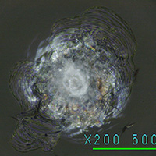
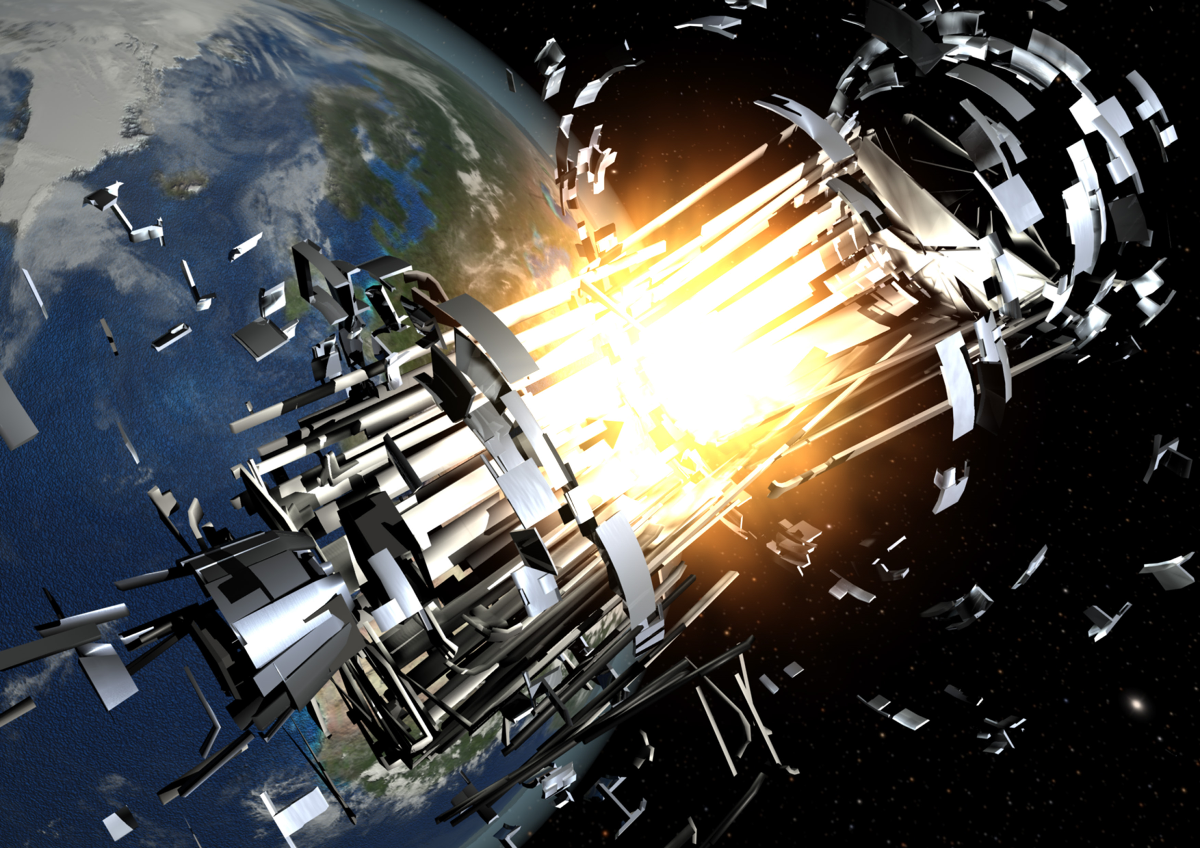
Orbital Debris Sources
Spent launch vehicle upper stages
Inactive spacecraft
Collisions
Small collisions (small particles, damage dependent on location)
Large collisions (> 10 cm, mission-killer)
Intentional collisions (anti-satellite tests)
Explosions
Residual fuel and oxidizer
Batteries
Pressurized tanks
Material degradation
Thermal blankets
Paint specks
Debris generated by large collisions can impact other large objects, creating further debris. This cascade-effect is known as the Kessler Syndrome.
Orbital debris damage on Shuttle window (1 mm diameter) from 0.03 mm stainless steel object (hvit.jsc.nasa.gov/impact-images/space-shuttle.cfm )
www.universetoday.com/13587/space-debris-illustrated-the-problem-in-pictures/

Slide 7
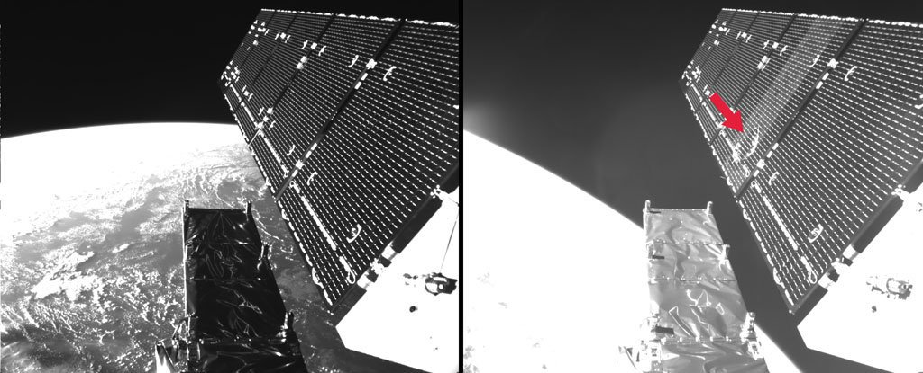
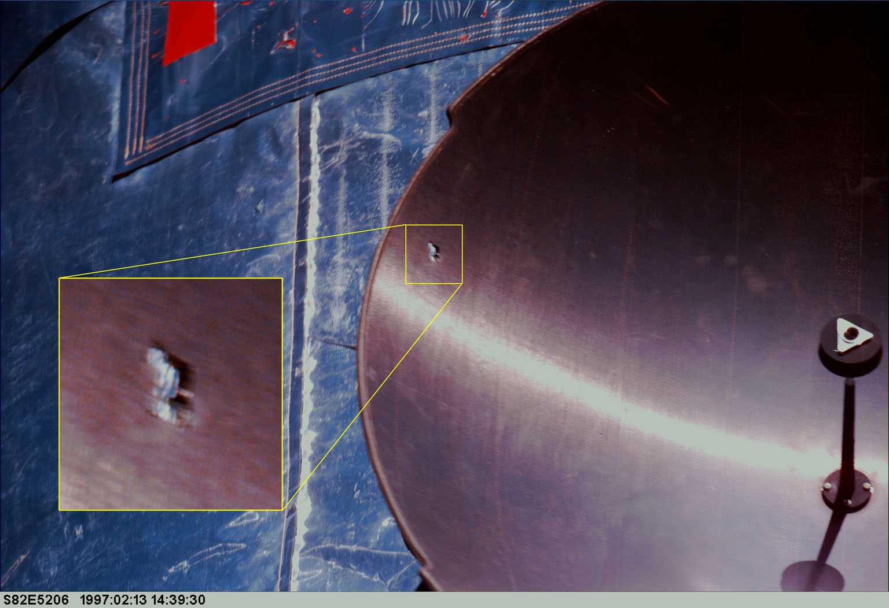
Examples: Particle Impact Damage
International Space Station
Sentinel 1-A (European Space Agency)
wonderfulengineering.com/satellite-survives-a-collision-with-400000-kmh-speeding-space-particle/
Hubble Space Telescope
Credit: Space News, NASA, ESA
Notes:
Photo credits: https://spacenews.com/op-ed-damage-to-canadarm2-on-iss-once-again-highlights-space-debris-problem/
https://www.esa.int/Space_Safety/Swarm_dodges_collision_during_climb_to_escape_Sun_s_wrath
Particle ~1cm, damage: 9 strings\connectors

Slide 8
Big Sky?
This was the status when we presented the first SE Seminar on Orbital Debris in 2017
Graph shows the number of spacecraft launched by year, regardless of current status.
It does not count launch vehicle upper stages nor orbital debris generated.
Data: Orbital Debris Program Office (ODPO), https://cosmoquest.org/x/2022/01/2021-year-in-review-statistics-and-satellites/
Notes:
1997-98 Launch of Iridium constellation (~88 satellites). 2018-2022 Launch of Starlink (~2675 satellites to date).

Slide 9
Big Sky? Really?
Graph shows the number of spacecraft launched by year, regardless of current status.
It does not count launch vehicle upper stages nor orbital debris generated.
Data: Orbital Debris Program Office (ODPO), https://cosmoquest.org/x/2022/01/2021-year-in-review-statistics-and-satellites/
Notes:
1997-98 Launch of Iridium constellation (~88 satellites). 2018-2022 Launch of Starlink (~2675 satellites to date).

Slide 10
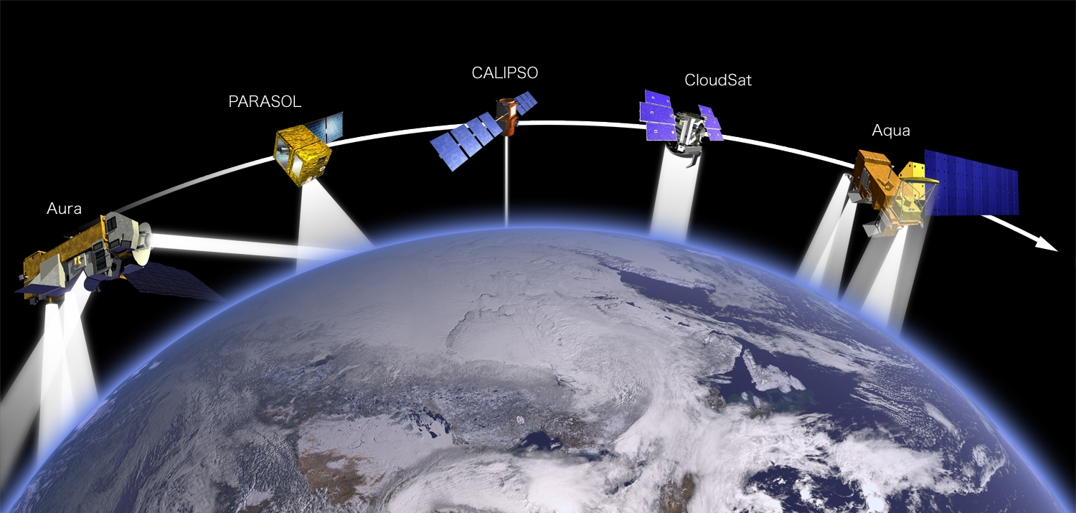
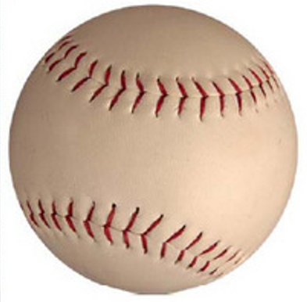
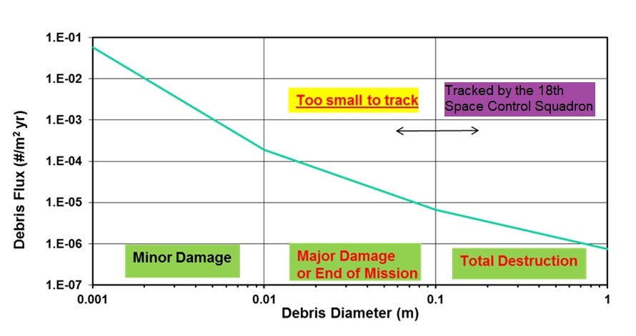
Example: Orbital Debris Flux at 705 km, 98°
https://www.nasa.gov/mission_pages/hurricanes/features/parasol.html
Flux: number of objects per square meter per year.
0.039 in
0.390 in
3.937 in
39.370 in
Notes:
Satellite image: https://www.nasa.gov/mission_pages/hurricanes/features/parasol.html

Slide 11
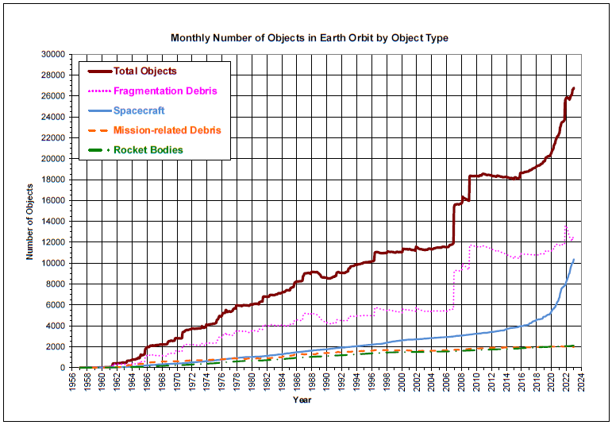
Number of Tracked Objects by Type
Cosmos-1408 destruction, 2021
Gradual increase: Large constellations
Iridium-Cosmos collision, 2009
Fengyun-1C destruction, 2007
Individual events !
https://orbitaldebris.jsc.nasa.gov/quarterly-news/pdfs/odqnv27i1.pdf , with added notes.

Slide 12
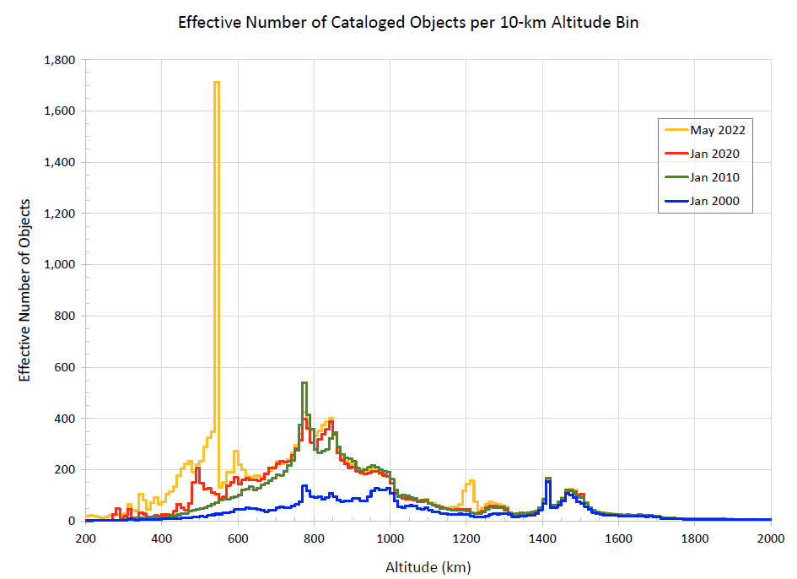
Object Density vs. Altitude
Main contributors to object increase by year range:
2000-2010:
Fengyun-1C anti-satellite test
2010-2020:
Starlink constellation starts, cubesats
2020-2022: Starlink, cubesats, OneWeb, Russia anti-satellite test.
Source: ODPO
Notes:
Iridium-Cosmos: ~ 800 km; Fengyun-1C: 865 km; Starlink, cubesats: < 650 km; OneWeb: 1200 km.

Slide 13
Mitigation and Prevention

Slide 14
Governing NASA Documents
NPR 8715.6B (with Change 2), NASA Procedural Requirements for Limiting Orbital Debris and Evaluating the Meteoroid and Orbital Debris Environments
Defines roles and responsibilities
Requires the projects to submit the Orbital Debris Assessment Report and the End of Mission Plan to Headquarters, and defines the timeline for those documents and their updates.
NASA-STD-8719.14C, Process for Limiting Orbital Debris
Lists the specific requirements applicable to each project; requirements vary depending on the mission operational environment and the level of NASA involvement.
Latest version follows the 2019 U.S. Government Orbital Debris Mitigation Standard Practices (2019 ODMSP).
Note: Orbital debris mitigation is also referenced in the NPR 7120.5E as part of the overall mission requirements.

Slide 15
ODAR in general
The Orbital Debris Assessment Report (ODAR) documents a Project’s compliance with NASA requirements to limit the generation of orbital debris.
The specific requirements are listed in the NASA-STD-8719.14C.
The initial ODAR is produced in Phase A *, and updated at PDR, CDR, and before Launch (Safety and Mission Success Review, or SMSR).
The ODAR is focused on the spacecraft design and general disposal plan.
Starting with the CDR update, the ODAR must include a Launch Vehicle assessment section, generally provided by the Launch Services Program.
When NASA provides an instrument to another Agency, a shorter version of the ODAR is produced (Abbreviated ODAR).
Cubesats are only required to submit the pre-launch (SMSR) ODAR, but may be beneficial to start earlier.
* Can be deferred
Notes:
Cubesats are not defined on the NPR or STD (minimum size).
“Missions that do not have a Mission Concept Review, may provide the initial ODAR at Systems Requirements Review. The Mission Concept Review ODAR is optional.” (NPR Table A, note 1)

Slide 16
End of Mission Plan in general
The End of Mission Plan (EOMP) addresses the same list of requirements as the ODAR, but with emphasis on the operational phase of the mission.
The initial EOMP is combined with the ODAR at SMSR.
The EOMP is then updated during the operational mission, typically at Senior Reviews, focusing on the spacecraft status and the maturity of the disposal plan.
Spacecraft anomalies may precipitate the End of Mission (EOM).
Mission extensions still have to consider the spacecraft capability to comply with the orbital debris requirements.
Cubesats do not require EOMP if they reenter the Earth passively in less than 25 years.

Slide 17
Basic Review Process (electronic)
GSFC
ODAR\EOMP electronic draft (preparer)
Project, Configuration Management (CM)
eRouting:
- Initiator (CM), preparer
- Project Manager
- CSO
- Code 300 SMA Orbital Debris Representative
- Others, as specified by Initiator
Initiator (Project)
Office of Safety & Mission Assurance (OSMA)
Program Executive
Concurrence by Evaluation
Headquarters:
Concurrence by forwarding the document.
When MDAA approval is required, each Directorate determines the approval method.
ODPO
CSO – Chief Safety & mission assurance Officer
MDAA – Mission Directorate Associate Administrator
ODPO – Orbital Debris Program Office
SMA – Safety & Mission Assurance
Notes:
STD: “Inside cover with the document preparer(s) and program management signatures.”

Slide 18
NASA Requirements
Full requirements text in Backup Slides
Mitigation & Prevention:

Slide 19
NASA-STD-8719.14C: 4.3 Assessment of Debris Released During Deployment and Normal Operations
4.3-1: Debris released in LEO (> 1mm)
Less than 25 years after release
Total object-time < 100 years
4.3-2: Debris released in GEO (> 5mm)
Stay away from GEO for at least 100 years
Intent:
Prevent or minimize the release of operational debris (like lens covers).
Regions:
LEO, GEO
Takeaways:
The requirement does not prohibit releasing operational debris, but discourages it.
EOMP also addresses operational debris resulting from passivation procedures.
Notes:
Requirement 4.3-1: Planned debris release passing through LEO – released debris with diameters of 1mm or larger:
a. Requirement 4.3-1a: All debris released during the deployment, operation, and disposal phases shall be limited to a maximum orbital lifetime of 25 years from date of release.
b. Requirement 4.3-1b: The total object-time product shall be no larger than 100 object-years per launch vehicle upper stage or per spacecraft.
Requirement 4.3-2: Planned debris passing near GEO: For missions leaving debris in orbits with the potential of traversing GEO (GEO altitude +/- 200 km and +/- 15 degrees inclination), released debris with diameters of 5 mm or greater shall be left in orbits which will ensure that within 25 years after release the apogee will no longer exceed GEO - 200 km or the perigee will not be lower than GEO + 200 km , and also ensures that the debris is incapable of being perturbed to lie within that GEO +/- 200 km and +/- 15 zone for at least 100 years thereafter.

Slide 20
NASA-STD-8719.14C: 4.4 Assessment of Debris Generated by Explosions
4.4-2: Passivation at EOM (tanks, batteries)
(1) Deplete sources of stored energy and disconnect energy generation sources, or
(2) Control to a level which cannot cause explosion
During mission:
4.4-1: Avoid accidental explosions during operations
Limit probability of explosion to < 0.001
After mission:
Intent:
Avoid accidental on-orbit explosions, during (4.4-1) and after the mission (4.4-2).
Regions:
All Earth orbits
Moon orbit
Takeaways:
For 4.4-2, the HQ\Office of Safety & Mission Assurance (OSMA) favors (1). To apply (2), the NASA Engineering & Safety Center (NESC) provides guidance in the NASA/TM-2020-5006131, Assessment of Spacecraft Passivation Techniques (Note: EAR protected).
Requirements 4.4-3 and 4.4-4 (not shown) pertain intentional breakups, which are not practiced at NASA.
Notes:
Requirement 4.4-1: Limiting the risk to other space systems from accidental explosions during deployment and mission operations while in orbit about Earth or the Moon: For each spacecraft and launch vehicle orbital stage employed for a mission (i.e., every individual free-flying structural object), the program or project shall demonstrate, via failure mode and effects analyses, probabilistic risk assessments, or other appropriate analyses, that the integrated probability of explosion for all credible failure modes of each spacecraft and launch vehicle is less than 0.001 (excluding small particle impacts.).
Requirement 4.4-2: Design for passivation after completion of mission operations while in orbit about Earth, or the Moon: Design of all spacecraft and launch vehicle orbital stages shall include the ability and a plan to either 1) deplete all onboard sources of stored energy and disconnect all energy generation sources when they are no longer required for mission operations or postmission disposal or 2) control to a level which cannot cause an explosion or deflagration large enough to release orbital debris or break up the spacecraft. The design of depletion burns and ventings should minimize the probability of accidental collision with tracked objects in space.

Slide 21
NASA-STD-8719.14C: 4.5 Assessment of Debris Generated by On-orbit Collisions
4.5-1: Probability of Collision with large objects (> 10cm)
< 0.001
4.5-2: Probability of Collision with small objects
< 0.01
Intent:
Minimize probability of collision with large (4.5-1, particle > 10 cm, mission-killer) and small (4.5-2, for disposal-critical components).
Regions:
All Earth orbits.
Takeaways:
Protection from large objects relies on conjunction assessments and collision avoidance maneuvers.
Protection from small objects relies on localized shielding.
Assessment methods to identify vulnerabilities can be applied to other components for mission success purposes.
In a constellation, the maximum risk is applied to a representative spacecraft. Risk is not cumulative.

Slide 22
NASA-STD-8719.14C: 4.6 Postmission Disposal of Space Structures (1 of 4)
4.6-1: Reentry and retrieval
Natural (uncontrolled) reentry: as soon as practical but < 25 years
Direct (controlled) reentry as soon as practical
Direct retrieval < 10 years
Intent:
Minimize accumulation of large debris to reduce collision risk.
Region:
LEO
Takeaways:
This is the source of the so-called “25-year rule”.
Most spacecraft below 600 km meet the requirement.
Uncontrolled reentry should meet the “25-years” rule and the Requirement 4.7-1 (more on this later).
FCC is using a 5-year limit, which does not apply to NASA.
Notes:
Requirement 4.6-1. Natural reentry, direct reentry, or direct retrieval shall comply with the following:
Natural reentry: Leave the space structure in an orbit in which, using conservative projections for solar activity, atmospheric drag will limit the orbital lifetime to as short as practicable but no more than 25 years after the completion of mission.
Direct reentry: Maneuver the space structure into a controlled de-orbit trajectory as soon as practical after completion of mission.
Direct retrieval: Retrieve the space structure and remove it from orbit within 10 years after completion of mission.

Slide 23
NASA-STD-8719.14C: 4.6 Postmission Disposal of Space Structures (2 of 4)
4.6-2 Storage and Earth Escape
Between LEO & GEO
Maneuver to highly-eccentric orbit *
Maneuver to near-circular orbit *
Earth escape
Heliocentric
Storage above GEO
Above 35,986 km for ≥ 100 years
* See requirement text for specific orbits in Backup Slides
Intent:
Minimize accumulation of large debris to reduce collision risk.
Regions:
GEO, MEO
Earth escape trajectory
Takeaways:
Requirement 4.6-2 defines the so-called “graveyard orbit” for GEO spacecraft.
In MEO, the main driver is to protect the GPS constellation.
It is recognized that propagating an orbit for 100 years involves large uncertainty and propagation errors. For this reason, it is enough to apply the current knowledge and tools to satisfy the requirement, even if the simulation is not as accurate as short-term predictions.
Notes:
Requirement 4.6-2. Storage and Earth escape shall comply with the following:
Storage between LEO and GEO:
Maneuver to a highly eccentric disposal orbit (e.g., GEO transfer orbit) where (i) perigee altitude remains above 2000 km for at least 100 years, (ii) apogee altitude remains below 35,586 km for at least 100 years, and (iii) the time spent by the space structure between 20,182 +/- 300 km is limited to 25 years or less over 200 years; or,
Maneuver to a near-circular disposal orbit to (i) avoid crossing 20,182 +/- 300 km, the GEO zone, and the LEO zone for at least 100 years, and (ii) limit the risk to other operational constellations, for example, by avoiding crossing the altitudes occupied by known missions of 10 or more spacecraft using near-circular orbits, for 100 years.
b. Storage above GEO: Maneuver to a disposal orbit above GEO with a predicted minimum perigee altitude of 35,986 km for a period of at least 100 years after disposal.
c. Earth escape: Maneuver to a heliocentric, Earth-escape trajectory.

Slide 24
NASA-STD-8719.14C: 4.6 Postmission Disposal of Space Structures (3 of 4)
4.6-3: Medium Earth Orbit, Tundra orbits, highly-inclined GEO, and others
Disposal orbit that increases the eccentricity over time
Lifetime as short as practicable but < 200 years
≤ 25 years (each) in: LEO, GEO, GPS orbit
Intent:
Minimize accumulation of large debris to reduce collision risk.
Regions:
MEO
Missions that cross more than one region (LEO-MEO, MEO-GEO)
Other long-term reentry orbits (undefined)
Takeaways:
Addresses missions that are not LEO-only, GEO-only, nor Earth-escape.
Not clear which “other orbits” are envisioned.
Notes:
Requirement 4.6-3. Long-term reentry for space structures in Medium Earth Orbit (MEO), Tundra orbits, highly inclined GEO, and other orbits shall:
a. Maneuver to a disposal orbit where orbital resonances will increase the eccentricity for long-term reentry of the space structure,
b. Limit the postmission orbital lifetime to as short as practicable but no more than 200 years,
c. Limit the time spent by the space structure in the LEO zone, the GEO zone, and between 20,182 +/- 300 km to 25 years or less per zone, and
d. Limit the probability of collisions with debris 10 cm and larger to less than 0.001 (1 in 1,000) during orbital lifetime.

Slide 25
NASA-STD-8719.14C: 4.6 Postmission Disposal of Space Structures (4 of 4)
4.6-4: Disposal operations
(a) 0.90 at EOM
(b) For controlled reentry, 0.90 at EOM and agreement with Req. 4.7-1
Intent:
Ensure that the planned disposal maneuvers are achieved.
Regions:
All Earth orbits.
Takeaways:
Post-mission disposal involves active maneuvers, for which a reliability value is computed.
For some missions, even the 0.90 is challenging.
Requirement 4.6-4.b is closely related to 4.7-1.c on risk to humans on the ground (next chart).
Notes:
Requirement 4.6-4. Reliability of postmission disposal maneuver operations in Earth orbit: NASA space programs and projects shall ensure that all postmission disposal operations to meet Requirements 4.6-1, 4.6-2, and/or 4.6-3 are designed for a probability of success as follows:
Be no less than 0.90 at EOM, and
b. For controlled reentry, the probability of success at the time of reentry burn must be sufficiently high so as not to cause a violation of Requirement 4.7-1 pertaining to limiting the risk of human casualty.

Slide 26
NASA-STD-8719.14C: 4.7 Debris Surviving Atmospheric Reentry (1 of 2)
4.7-1: Risk of human casualty
Uncontrolled reentry: Risk < 0.0001 (1:10,000)
Controlled reentry
Long-term reentry: < 7 m² DCA or 0.0001 risk of human casualty
> 370 km from foreign landmasses, > 50 km from US and territories.
Risk uncontrolled x Probability of Failure of reentry burn < 0.0001
Intent:
Limit the risk of human casualty
Regions:
LEO
“Long-term reentry” orbits
Takeaways:
4.7-1.a and .c: To assess the spacecraft for reentry risk, the Debris Assessment Software (DAS) is available in the NASA Software Catalog. DAS is conservative.
In a constellation, risk is assessed for a representative spacecraft (risk is not cumulative).
Even relatively small spacecraft (not cubesats) can exceed the 1:10,000 if the payload contains many temperature-resistant components (titanium, tungsten, stainless steel in large size).
4.7-1.b: In the ODAR, a simple deorbit plan is enough to demonstrate that the hardware has enough controllability to avoid the protected zones. More details are added in the EOMP.
DCA = Debris Casualty Area, area at risk plus 0.36 m² (estimated area of person)
Notes:
Requirement 4.7-1. Limit the risk of human casualty: The potential for human casualty is assumed for any object with an impacting kinetic energy in excess of 15 joules:
For uncontrolled reentry, the risk of human casualty from surviving debris shall less than 0.0001 (1:10,000).
b. For controlled reentry, the selected trajectory shall ensure that no surviving debris impact with a kinetic energy greater than 15 joules is closer than 370 km from foreign landmasses, or is within 50 km from the continental U.S., territories of the U.S., and the permanent ice pack of Antarctica.
c. For controlled reentry, the product of the probability of failure to execute the reentry burn and the risk of human casualty assuming uncontrolled reentry shall not exceed 0.0001 (1:10,000).
d. For long-term reentry of space structures in MEO, Tundra orbits, highly inclined GEO, and other orbits: Surviving debris shall have less than 7 m² total debris casualty area or 0.0001 (1 in 10,000) risk of human casualty.

Slide 27
NASA-STD-8719.14C: 4.7 Debris Surviving Atmospheric Reentry (2 of 2)
Notes on Debris Casualty Area
Definition: “For a piece of debris that survives atmospheric reentry, the DCA is a function of the average debris cross-sectional area plus a computation for its interaction with the cross-section of an individual.” (Section 4.7.4.1)
The STD gives the following equation to compute the DCA:
$D_{A}=\sum_{i=1}^{N}{{(0.6+\sqrt{A_{i}})}^{2}}$, where N is the number of surviving objects and A_{i} is the average cross-sectional area.
It also references the Opiela-Matney formula, that is used in DAS for each object (Section 4.7.4.2):
$DCA=0.278+A_{obj}+1.39×\sqrt{A_{obj}}$ , where A_{obj} is the projected area.

Slide 28
NASA-STD-8719.14C: 4.8 Additional Assessment Requirements for Special Classes of Space Missions
4.8-1: Special classes:
- Large constellations
- Rendezvous, proximity operations, and satellite servicing
- Active debris removal
- Tethers
- Small satellites
Requirements 4.3-4.7
Objective 5 of 2019 ODMSP (see next chart)
Other
Small sats < 1U as operational debris
Tether systems
Intent:
Limit the collision risk due to severed tethers, large constellations, satellite servicing, and others.
Regions:
All Earth orbits.
Takeaway:
Tethers are rarely used. The requirement applies to tethers longer than 300 meters.
Cubesats less than 1U are treated like operational debris: < 25 years, < 100 object-years.
“Large constellations” are defined as having 100 spacecraft or more.
Notes:
Requirement 4.8-1. Special classes of space missions: Special classes of space missions, including large constellations; rendezvous, proximity operations, and satellite servicing; safety of active debris removal operations; tethers; and small satellites, shall comply with (1) the requirements in Sections 4.3 through 4.7, (2) the applicable mitigation standard practices established in Objective 5 of the 2019 ODMSP, and (3) the following:
Tether systems: Intact and remnants of severed tether systems in Earth orbit shall limit the generation of orbital debris from on-orbit collisions with other operational spacecraft. Tether systems should generally not remain deployed after the completion of their mission objectives. After mission objectives are met, such tethers should have provisions for disposal (full retraction/stowing and/or removal from Earth orbit) with a probability of success greater than 0.9. Those provisions include an assessment of the reliability of the disposal system and accounting for the possibility of damage to or cutting of the tether prior to disposal.
b. Small satellites, including CubeSats: For spacecraft smaller than 10 cm × 10 cm × 10 cm when fully deployed:
(1) Any spacecraft in LEO shall be limited to an orbital lifetime as short as practicable but no more than 25 years after completion of mission.
(2) The total spacecraft object-time product in LEO shall be less than 100 object-years per mission.

Slide 29
2019 Orbital Debris Mitigation Standard Practices – Objective 5, Special Cases
2019 ODMSP Objective 5: Special cases
Large constellations: disposal reliability 0.90 with goal of 0.99 or better.
Small satellites: < 25 years disposal, < 100 object years
Rendezvous, proximity operations, and satellite servicing: limit collision and explosion risk resulting from operations
Active Debris Removal: avoid fragmentation of target debris, and limit probability of collision and explosion
Tether systems: analyze for collision risk
Takeaways:
2019 ODMSP requirements apply to relevant U.S. Government agencies, which then prescribe them to missions to which they provide licenses.
Objective 5 is more specific than 4.8-1 of NASA-STD, but all goes down to prevent collisions and explosions, and proper disposal at EOM.
Notes:
2019 ODMSP Objective 5: Clarification and Additional Standard Practices for Certain Classes of Space Operations
5-1. Large Constellations: A constellation consisting of 100 or more operational spacecraft cumulative is considered a large constellation.
Each spacecraft in a large constellation should have a probability of successful postmission disposal at a level greater than 0.9 with a goal of 0.99 or better. In determining the successful postmission disposal threshold, factors such as mass, collision probability, orbital location, and other relevant parameters should be considered.
For large constellations, Objective 4-1.a. [Direct reentry or heliocentric orbit] is the preferred postmission disposal option for the spacecraft. In developing the mission profile, the program should limit the cumulative reentry human casualty risk from the constellation.
5-2. Small satellites, including CubeSats [Same as NASA-STD-8719.14C Requirement 4.8-1.b]
5-3. Rendezvous, proximity operations, and satellite servicing: In developing the mission profile for a structure, the program should limit the risk of debris generation as an outcome of the operations. The program should (1) limit the probability of accidental collision, and (2) limit the probability of accidental explosion resulting from the operations. Any planned debris generated as a result of the operations should follow the standard practices for mission-related debris set forth in Objective 1 [Equivalent to NASA-STD-8719.14C Requirement 4.3-1 on operational debris].

Slide 30
Remediation: The Challenges of Orbital Debris Removal

Slide 31
Impetus to Remove Debris Objects
Obviously, to reduce the amount of debris in orbit
Big objects break up to make hundreds or thousands of smaller objects, most too small to track
Space is more congested than it was decades ago
Existing and future debris affects everyone: commercial, civilian, military, international
National Orbital Debris Implementation Plan, July 2022
( https://www.whitehouse.gov/wp-content/uploads/2022/07/07-2022-NATIONAL-ORBITAL-DEBRIS-IMPLEMENTATION-PLAN.pdf#:~:text=This%20Orbital%20Debris%20Implementation%20Plan%20provides%20tangible%20actions,coordinated%20efforts%20across%20U.S.%20Government%20departments%20and%20agencies )
US White House document; 14 pages
Remediation efforts focused on studying and developing capabilities and effectiveness
NASA is assigned lead or support role on every initiative

Slide 32
Challenges to Removing Large Debris (defined as larger than 1 m)
Technical
Grappling/attach methods can differ
Detumbling large bodies (LV upper stages)
Financial
Still very expensive
Who pays for removal?
Multiple removals per launch can reduce cost, but increase complexity
Policy
One person’s removal technology is another’s potential weapon
Large debris is owned by several different countries

Slide 33
Challenges to Removing SmallSat Debris (defined as 2 cm to 1 m)
Technical
Tracking from the ground still has large uncertainty
Capture method: don’t make more debris
How much do you collect before reentry? Lots of fuel
Laser nudging: see next slide
Financial
Still very expensive
Who pays for removal?
Policy
One person’s removal technology is another’s potential weapon
Existing debris is owned by several different countries

Slide 34
Challenges to Removing Small Debris (defined as smaller than 2 cm)
Technical
How to collect/capture
Deorbiting after capture (esp. capture at > 600 km)
Laser nudging: tracking, accurate aim
Financial
Still very expensive
Who pays for removal?
Policy
Ground-based lasers are especially suspicious
Collision avoidance with the large collector spacecraft

Slide 35
Cost and Benefit Analysis of Orbital Debris Remediation (Large > 10 cm > Small >1 cm)
Released March 2023; 147 pages
https://www.nasa.gov/sites/default/files/atoms/files/otps_-_cost_and_benefit_analysis_of_orbital_debris_remediation_-_final.pdf
Benefits of removing the ‘Top 50’ increase every year into the future
Finding 1: The most effective remediation methods to reduce risks to operators are approaches for removing small debris and nudging large debris to avoid collisions.
Finding 2: Controlled and uncontrolled reentry via reusable remediation servicer may reach net benefits on timescales that are relevant to spacecraft operators.
Finding 3: Recycling space debris has some attractive features but does not offer a clear risk advantage over other approaches.

Slide 36
Remediation Bottom Line
Large debris
We have most of the technology and a list of targets
Money and policy issues are preventing this from happening
At some point somebody is going to break the ice
A few companies are looking to develop this as a service
SmallSat debris
Lasers look attractive to some folks, terrifying to others
Tracking accuracy drops off with object size
Capture technologies are not standardized
Small debris
Collectors may have promise, but have challenges
Lasers look attractive to some folks, terrifying to others

Slide 37
Questions ?

Slide 38
References
NASA-STD-8719.14C, Process for Limiting Orbital Debris
NPR 8715.6B, NASA Procedural Requirements for Limiting Orbital Debris and Evaluating the Meteoroid and Orbital Debris Environments
U.S. Government Orbital Debris Mitigation Standard Practices, November 2019 Update.
NASA/TM-2020-5006131, Assessment of Spacecraft Passivation Techniques (EAR protected)
NPR 7120.5F, NASA Space Flight Program and Project Management Requirements (with Change 1)
NASA/TM-2020-5006131, Assessment of Spacecraft Passivation Techniques (EAR protected)
National Orbital Debris Implementation Plan, July 2022.

Slide 40
Backup Slides

Slide 41
International Orbital Debris Mitigation Efforts
(International)
(National)
Inter-Agency Space Debris Coordination Committee (IADC Space Debris Mitigation Guidelines (nasa.gov) )
United States Government – 2019 US Government Orbital Debris Mitigation Standard Practices (https://orbitaldebris.jsc.nasa.gov/library/usg_orbital_debris_mitigation_standard_practices_november_2019.pdf )
Guidance
Guidance
Inputs
Requirements
Space agencies from 13 countries
NASA
Department Of Defense
National Oceanic & Atmospheric Administration (NOAA): Earth observation spacecraft
Federal Aviation Administration (FAA): launch vehicles
Federal Communications Commission (FCC): communication satellites

Slide 42
NASA-STD-8719.14C: 4.3 Assessment of Debris Released During Deployment and Normal Operations
Requirement 4.3-1: Planned debris release passing through LEO – released debris with diameters of 1mm or larger:
a. Requirement 4.3-1a: All debris released during the deployment, operation, and disposal phases shall be limited to a maximum orbital lifetime of 25 years from date of release.
b. Requirement 4.3-1b: The total object-time product shall be no larger than 100 object-years per launch vehicle upper stage or per spacecraft.
Requirement 4.3-2: Planned debris passing near GEO: For missions leaving debris in orbits with the potential of traversing GEO (GEO altitude +/- 200 km and +/- 15 degrees inclination), released debris with diameters of 5 mm or greater shall be left in orbits which will ensure that within 25 years after release the apogee will no longer exceed GEO - 200 km or the perigee will not be lower than GEO + 200 km , and also ensures that the debris is incapable of being perturbed to lie within that GEO +/- 200 km and +/- 15 zone for at least 100 years thereafter.
Intent:
Prevent or minimize the release of operational debris (like lens covers).
Region:
LEO, GEO
Takeaways:
The requirement does not prohibit releasing operational debris, but discourages it.
EOMP also addresses operational debris resulting from passivation procedures.

Slide 43
NASA-STD-8719.14C: 4.4 Assessment of Debris Generated by Explosions
Requirement 4.4-1: Limiting the risk to other space systems from accidental explosions during deployment and mission operations while in orbit about Earth or the Moon: For each spacecraft and launch vehicle orbital stage employed for a mission (i.e., every individual free-flying structural object), the program or project shall demonstrate, via failure mode and effects analyses, probabilistic risk assessments, or other appropriate analyses, that the integrated probability of explosion for all credible failure modes of each spacecraft and launch vehicle is less than 0.001 (excluding small particle impacts.).
Requirement 4.4-2: Design for passivation after completion of mission operations while in orbit about Earth, or the Moon: Design of all spacecraft and launch vehicle orbital stages shall include the ability and a plan to either 1) deplete all onboard sources of stored energy and disconnect all energy generation sources when they are no longer required for mission operations or postmission disposal or 2) control to a level which cannot cause an explosion or deflagration large enough to release orbital debris or break up the spacecraft. The design of depletion burns and ventings should minimize the probability of accidental collision with tracked objects in space.
Intent:
Avoid accidental on-orbit explosions, during (4.4-1) and after the mission (4.4-2).
Regions:
All Earth orbits
Moon orbit
Takeaways:
For 4.4-2, the HQ\Office of Safety & Mission Assurance (OSMA) favors (1). To apply (2), the NASA Engineering & Safety Center (NESC) provides guidance in the NASA/TM-2020-5006131, Assessment of Spacecraft Passivation Techniques (Note: EAR protected).
Requirements 4.4-3 and 4.4-4 (not shown) pertains intentional breakups, which are not in practice at NASA.

Slide 44
NASA-STD-8719.14C: 4.5 Assessment of Debris Generated by On-orbit Collisions
Requirement 4.5-1. Limiting debris generated by collisions with large objects when in Earth orbit: For each spacecraft and launch vehicle orbital stage, the program or project shall demonstrate that, during the orbital lifetime of each spacecraft and orbital stage, the probability of accidental collision with space objects larger than 10 cm in diameter is less than 0.001. For the purpose of this assessment, 100 years is used as the maximum orbital lifetime for the storage disposal option.
Requirement 4.5-2. Limiting debris generated by collisions with small objects when operating in Earth orbit: For each spacecraft, the program or project shall demonstrate that, during the mission of the spacecraft, the probability of accidental collision with orbital debris and meteoroids sufficient to prevent compliance with the applicable postmission disposal maneuver requirements is less than 0.01.
Intent:
Minimize probability of collision with large (4.5-1, particle > 10 cm, mission-killer) and small (4.5-2, for disposal-critical components).
Regions:
All Earth orbits.
Takeaways:
Protection from large objects relies on conjunction assessments and collision avoidance maneuvers.
Protection from small objects relies on localized shielding.
Assessment methods can be applied to other components for mission success purposes.
In a constellation, the 0.001 and 0.01 corresponding limits are applied to a representative spacecraft. Risk is not cumulative.

Slide 45
NASA-STD-8719.14C: 4.6 Postmission Disposal of Space Structures (1 of 4)
Requirement 4.6-1. Natural reentry, direct reentry, or direct retrieval shall comply with the following:
Natural reentry: Leave the space structure in an orbit in which, using conservative projections for solar activity, atmospheric drag will limit the orbital lifetime to as short as practicable but no more than 25 years after the completion of mission.
Direct reentry: Maneuver the space structure into a controlled de-orbit trajectory as soon as practical after completion of mission.
Direct retrieval: Retrieve the space structure and remove it from orbit within 10 years after completion of mission.
Intent:
Minimize accumulation of large debris to reduce collision risk.
Region(s):
LEO
Takeaways:
This is the source of the so-called “25-year rule”.
Most spacecraft below 600 km meet the requirement.
Uncontrolled reentry should meet the “25-years” rule AND the Requirement 4.7-1 (more on this later).

Slide 46
NASA-STD-8719.14C: 4.6 Postmission Disposal of Space Structures (2 of 4)
Requirement 4.6-2. Storage and Earth escape shall comply with the following:
Storage between LEO and GEO:
Maneuver to a highly eccentric disposal orbit (e.g., GEO transfer orbit) where (i) perigee altitude remains above 2000 km for at least 100 years, (ii) apogee altitude remains below 35,586 km for at least 100 years, and (iii) the time spent by the space structure between 20,182 +/- 300 km is limited to 25 years or less over 200 years; or,
Maneuver to a near-circular disposal orbit to (i) avoid crossing 20,182 +/- 300 km, the GEO zone, and the LEO zone for at least 100 years, and (ii) limit the risk to other operational constellations, for example, by avoiding crossing the altitudes occupied by known missions of 10 or more spacecraft using near-circular orbits, for 100 years.
b. Storage above GEO: Maneuver to a disposal orbit above GEO with a predicted minimum perigee altitude of 35,986 km for a period of at least 100 years after disposal.
c. Earth escape: Maneuver to a heliocentric, Earth-escape trajectory.
Intent:
Minimize accumulation of large debris to reduce collision risk.
Regions:
GEO, MEO
Earth escape trajectory
Takeaways:
Requirement 4.6-2 defines the so-called “graveyard orbit” for GEO spacecraft.
In MEO, the main driver is to protect the GPS constellation.
It is recognized that propagating an orbit for 100 years involve large uncertainty and propagation errors. For this reason, it is enough to apply the current knowledge and tools to satisfy the requirement, even if the simulation is not as accurate as short-term predictions.

Slide 47
NASA-STD-8719.14C: 4.6 Postmission Disposal of Space Structures (3 of 4)
Requirement 4.6-3. Long-term reentry for space structures in Medium Earth Orbit (MEO), Tundra orbits, highly inclined GEO, and other orbits shall:
a. Maneuver to a disposal orbit where orbital resonances will increase the eccentricity for long-term reentry of the space structure,
b. Limit the postmission orbital lifetime to as short as practicable but no more than 200 years,
c. Limit the time spent by the space structure in the LEO zone, the GEO zone, and between 20,182 +/- 300 km to 25 years or less per zone, and
d. Limit the probability of collisions with debris 10 cm and larger to less than 0.001 (1 in 1,000) during orbital lifetime.
Intent:
Minimize accumulation of large debris to reduce collision risk.
Regions:
MEO
Missions that cross more than one region (LEO-MEO, MEO-GEO)
Other long-term reentry orbits (undefined)
Takeaways:
Addresses missions that are not LEO-only, GEO-only, nor Earth-escape.
Not clear which “other orbits” are envisioned.

Slide 48
NASA-STD-8719.14C: 4.6 Postmission Disposal of Space Structures (4 of 4)
Requirement 4.6-4. Reliability of postmission disposal maneuver operations in Earth orbit: NASA space programs and projects shall ensure that all postmission disposal operations to meet Requirements 4.6-1, 4.6-2, and/or 4.6-3 are designed for a probability of success as follows:
Be no less than 0.90 at EOM, and
b. For controlled reentry, the probability of success at the time of reentry burn must be sufficiently high so as not to cause a violation of Requirement 4.7-1 pertaining to limiting the risk of human casualty.
Intent:
Ensure that the planned disposal is achieved.
Regions:
All Earth orbits.
Takeaways:
Post-mission disposal involves active maneuvers, for which a reliability value is computed. Not applicable to spacecraft without propulsion system.
For many missions, a probability of success needed to limit the risk of human casualty is much less than 0.90 (4.6-4.b), so the main driver for compliance is meeting the 0.90 (4.6-4.a).
Requirement 4.6-4.b is closely related to 4.7-1.c (next chart).

Slide 49
NASA-STD-8719.14C: 4.7 Survival of Debris From the Postmission Disposal Earth Atmospheric Reentry Option
Requirement 4.7-1. Limit the risk of human casualty: The potential for human casualty is assumed for any object with an impacting kinetic energy in excess of 15 joules:
For uncontrolled reentry, the risk of human casualty from surviving debris shall less than 0.0001 (1:10,000).
b. For controlled reentry, the selected trajectory shall ensure that no surviving debris impact with a kinetic energy greater than 15 joules is closer than 370 km from foreign landmasses, or is within 50 km from the continental U.S., territories of the U.S., and the permanent ice pack of Antarctica.
c. For controlled reentry, the product of the probability of failure to execute the reentry burn and the risk of human casualty assuming uncontrolled reentry shall not exceed 0.0001 (1:10,000).
d. For long-term reentry of space structures in MEO, Tundra orbits, highly inclined GEO, and other orbits: Surviving debris shall have less than 7 m² total debris casualty area or 0.0001 (1 in 10,000) risk of human casualty.
Intent:
Limit the risk of human casualty
Regions:
LEO
“Long-term reentry” orbits
Takeaways:
4.7-1.a: To assess the spacecraft for reentry risk, the Debris Assessment Software (DAS) is available in the NASA Software Catalog. DAS is conservative.
In a constellation, risk is assessed for a representative spacecraft (risk is not cumulative). Every reentry is a separate event.
Even relatively small spacecraft (not cubesats) can exceed the 1:10,000 if the payload contains many temperature-resistant components (titanium, tungsten, stainless steel in large size).
4.7-1.b: In the ODAR, a simple deorbit plan is enough to demonstrate that the hardware has enough controllability to avoid the protected zones. More details are then added in the EOMP as the disposal procedures mature.

Slide 50
NASA-STD-8719.14C: 4.8 Additional Assessment Requirements for Special Classes of Space Missions (1 of 2)
Requirement 4.8-1. Special classes of space missions: Special classes of space missions, including large constellations; rendezvous, proximity operations, and satellite servicing; safety of active debris removal operations; tethers; and small satellites, shall comply with (1) the requirements in Sections 4.3 through 4.7, (2) the applicable mitigation standard practices established in Objective 5 of the 2019 ODMSP, and (3) the following:
Tether systems: Intact and remnants of severed tether systems in Earth orbit shall limit the generation of orbital debris from on-orbit collisions with other operational spacecraft. Tether systems should generally not remain deployed after the completion of their mission objectives. After mission objectives are met, such tethers should have provisions for disposal (full retraction/stowing and/or removal from Earth orbit) with a probability of success greater than 0.9. Those provisions include an assessment of the reliability of the disposal system and accounting for the possibility of damage to or cutting of the tether prior to disposal.
b. Small satellites, including CubeSats: For spacecraft smaller than 10 cm × 10 cm × 10 cm when fully deployed:
(1) Any spacecraft in LEO shall be limited to an orbital lifetime as short as practicable but no more than 25 years after completion of mission.
(2) The total spacecraft object-time product in LEO shall be less than 100 object-years per mission.
Intent:
Limit the collision risk due to severed tethers, large constellations, satellite servicing, and others.
Regions:
All Earth orbits.
Takeaway:
Tethers are rarely used. The requirement applies to tethers longer than 300 meters.
Cubesats less than 1U are treated like operational debris.
“Large constellations” are defined as having 100 spacecraft or more.

Slide 51
NASA-STD-8719.14C: 4.8 Additional Assessment Requirements for Special Classes of Space Missions (2 of 2)
For completeness, the text of the 2019 ODMSP Objective 5 is reproduced below. Red text in [ ] are additions for reference.
2019 ODMSP Objective 5: Clarification and Additional Standard Practices for Certain Classes of Space Operations
5-1. Large Constellations: A constellation consisting of 100 or more operational spacecraft cumulative is considered a large constellation.
Each spacecraft in a large constellation should have a probability of successful postmission disposal at a level greater than 0.9 with a goal of 0.99 or better. In determining the successful postmission disposal threshold, factors such as mass, collision probability, orbital location, and other relevant parameters should be considered.
For large constellations, Objective 4-1.a. [Direct reentry or heliocentric orbit] is the preferred postmission disposal option for the spacecraft. In developing the mission profile, the program should limit the cumulative reentry human casualty risk from the constellation.
5-2. Small satellites, including CubeSats [Same as NASA-STD-8719.14C Requirement 4.8-1.b]
5-3. Rendezvous, proximity operations, and satellite servicing: In developing the mission profile for a structure, the program should limit the risk of debris generation as an outcome of the operations. The program should (1) limit the probability of accidental collision, and (2) limit the probability of accidental explosion resulting from the operations. Any planned debris generated as a result of the operations should follow the standard practices for mission-related debris set forth in Objective 1 [Equivalent to NASA-STD-8719.14C Requirement 4.3-1 on operational debris].
Takeaways:
2019 ODMSP Requirement 5-1 is imposed on relevant U.S. Government agencies, which then prescribes them to missions to which they provide licenses.
2019 ODMSP Requirement 5-3 does not involve new constraints. By following the NASA-STD requirements the goal is met.

Slide 52
Disposal Method Summary
Perigee | Mission Type | Mass | Likely Simplest Disposal Method | --------------------------- Assessments Needed ----------------------
 |  |  |  | Passivation? | Collision Risk? | MMOD Penetration? | Disposal Reliability? | Reentry Risk?
< 650 km | High Energy | <250 kg | Uncontrolled reentry | Yes | Yes | No | No | Yes
< 650 km | High Energy | >250 kg | Controlled reentry | No | Yes | Yes | Yes | Yes
< 650 km | All Others | <800 kg | Uncontrolled reentry | Yes | Yes | No | No | Yes
< 650 km | All Others | >800 kg | Controlled reentry | No | Yes | Yes | Yes | Yes
650-1500 km | High Energy | <250 kg | Orbit lowering + Uncontrolled reentry | Yes | Yes | No | No | Yes
650-1500 km | High Energy | >250 kg | Controlled reentry | No | Yes | Yes | Yes | Yes
650-1500 km | All Others | <800 kg | Orbit lowering + Uncontrolled reentry | Yes | Yes | No | No | Yes
650-1500 km | All Others | >800 kg | Controlled reentry | No | Yes | Yes | Yes | Yes
1500-GEO | All Missions | All | Super-LEO storage | Yes | Yes | If maneuver is needed | If maneuver is needed | No
GEO 'bagel' | All Missions | All | Super-GEO storage | Yes | Yes | Yes | Yes | No
> GEO | All Missions | All | Heliocentric/ Disposal in place | Recommended | No | No | No | No
High energy missions includes X-ray and others.

Slide 53
Acronyms List
CDR | Critical Design Review
CM | Configuration Management
CSO | Chief Safety & Mission Assurance Officer
DAS | Debris Assessment Software
DCA | Debris Casualty Area
EAR | Export Administrations Regulations
EOM | End of Mission
EOMP | End of Mission Plan
FCC | Federal Communications Commission
GEO | Geostationary Earth Orbit
GPS | Global Positioning System
GSFC | Goddard Space Flight Center
LEO | Low Earth Orbit
MDAA | Mission Directorate Associate Administrator
MEO | Medium Earth Orbit
NESC | NASA Engineering & Safety Center
NPR | NASA Procedural Requirements
MLI | Multi-Layer Insulation
ODAR | Orbital Debris Assessment Report
ODMSP | (U.S. Government) Orbital Debris Mitigation Standard Practices
OIG | Office of Inspector
OSMA | Office of Safety & Mission Assurance
PDR | Preliminary Design Review
SE | Systems Engineering
SMSR | Safety and Mission Success Review
STD | Standard

